Slide 1






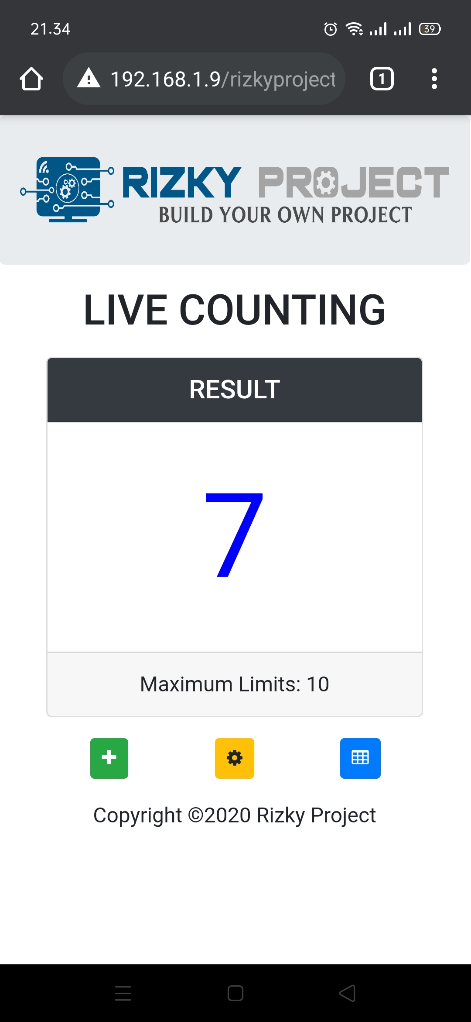
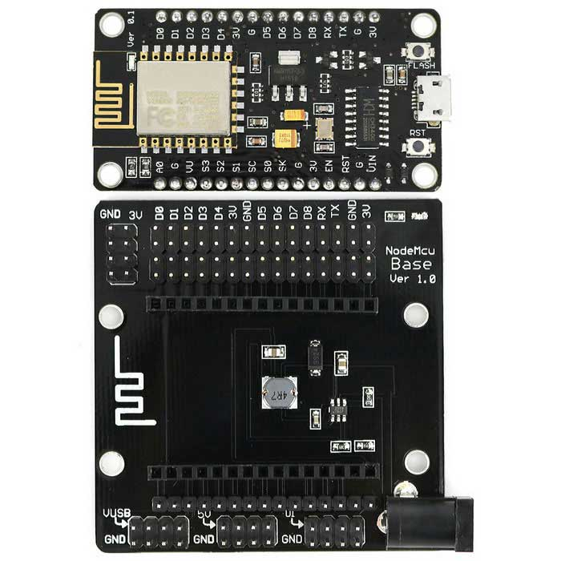
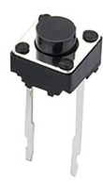
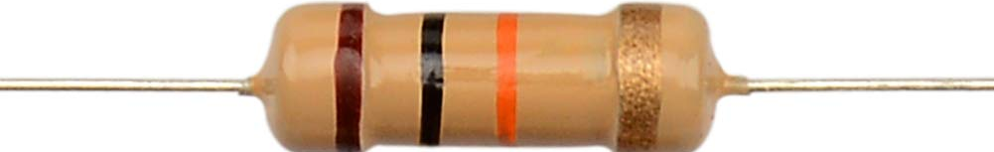
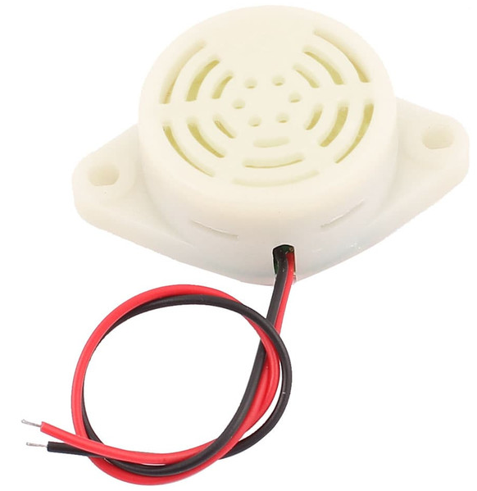
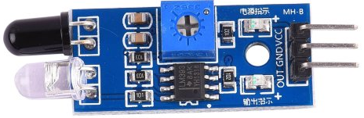
LIVE COUNTING
Nodemcu Board
Push Button
Features:
Live data realtime
Record data
Set Maximum Limit
Show, update, delete
data record
Reset counter
Indikator Limit Warning
R 10K
IR Obstacle Sensor
Buzzer 3 – 24V

Slide 2
Nodemcu Board
Push Button
IR -> D3
Button -> D2
Buzzer -> D1
R 10K
IR Obstacle Sensor

